Slide 1
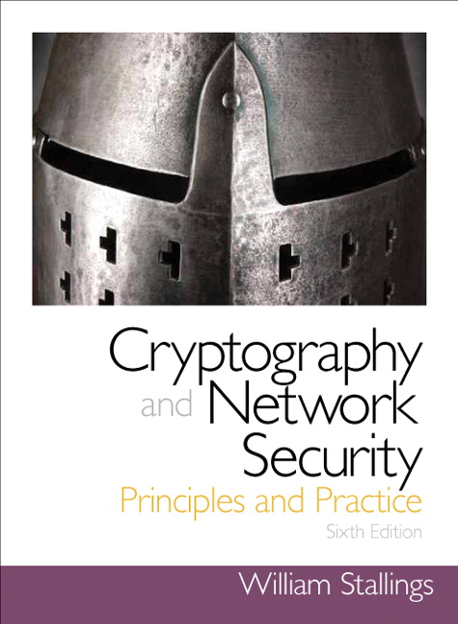
Cryptography and Network Security
Sixth Edition
by William Stallings
Notes:
Lecture slides prepared for “Cryptography and Network Security”, 6/e, by William Stallings, Chapter 19 – “Electronic Mail Security”.

Slide 2
Chapter 19
Electronic Mail Security
Notes:
In virtually all distributed environments, electronic mail is the most heavily used
network-based application. Users expect to be able to, and do, send e-mail to others
who are connected directly or indirectly to the Internet, regardless of host operating
system or communications suite. With the explosively growing reliance on e-mail,
there grows a demand for authentication and confidentiality services. Two schemes
stand out as approaches that enjoy widespread use: Pretty Good Privacy (PGP) and
S/MIME. Both are examined in this chapter. The chapter closes with a discussion of
DomainKeys Identified Mail.

Slide 3
“Despite the refusal of VADM Poindexter and LtCol North to appear, the Board's access to other sources of information filled much of this gap. The FBI provided documents taken from the files of the National Security Advisor and relevant NSC staff members, including messages from the PROF system between VADM Poindexter and LtCol North. The PROF messages were conversations by computer, written at the time events occurred and presumed by the writers to be protected from disclosure. In this sense, they provide a first-hand, contemporaneous account of events.”
—The Tower Commission Report to President Reagan on the Iran-Contra Affair,
1987
Notes:
Opening quote.

Slide 4
Pretty Good Privacy (PGP)
Provides a confidentiality and authentication service that can be used for electronic mail and file storage applications
Developed by Phil Zimmermann
Selected the best available cryptographic algorithms as building blocks
Integrated these algorithms into a general-purpose application that is independent of operating system and processor and that is based on a small set of easy-to-use commands
Made the package and its documentation, including the source code, freely available via the Internet, bulletin boards, and commercial networks
Entered into an agreement with a company to provide a fully compatible, low-cost commercial version of PGP
Notes:
PGP is a remarkable phenomenon. Largely the effort of a single person, Phil
Zimmermann, PGP provides a confidentiality and authentication service that can
be used for electronic mail and file storage applications. In essence, Zimmermann
has done the following:
1. Selected the best available cryptographic algorithms as building blocks.
2. Integrated these algorithms into a general-purpose application that is independent
of operating system and processor and that is based on a small set of
easy-to-use commands.
3. Made the package and its documentation, including the source code, freely
available via the Internet, bulletin boards, and commercial networks such as
AOL (America On Line).
4. Entered into an agreement with a company (Viacrypt, now Network
Associates) to provide a fully compatible, low-cost commercial version of PGP.

Slide 5
PGP Growth
Notes:
PGP has grown explosively and is now widely used. A number of reasons can
be cited for this growth.
1. It is available free worldwide in versions that run on a variety of platforms, including
Windows, UNIX, Macintosh, and many more. In addition, the commercial
version satisfies users who want a product that comes with vendor support.
2. It is based on algorithms that have survived extensive public review and are
considered extremely secure. Specifically, the package includes RSA, DSS, and
Diffie-Hellman for public-key encryption; CAST-128, IDEA, and 3DES for
symmetric encryption; and SHA-1 for hash coding.
3. It has a wide range of applicability, from corporations that wish to select and
enforce a standardized scheme for encrypting files and messages to individuals
who wish to communicate securely with others worldwide over the Internet
and other networks.
4. It was not developed by, nor is it controlled by, any governmental or standards
organization. For those with an instinctive distrust of “the establishment,” this
makes PGP attractive.
5. PGP is now on an Internet standards track (RFC 3156; MIME Security with
OpenPGP ). Nevertheless, PGP still has an aura of an antiestablishment
endeavor.

Slide 6
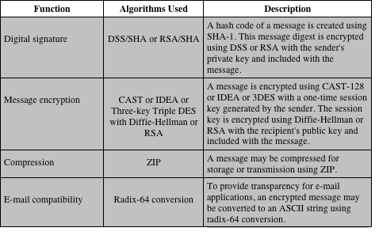
Table 19.1
Summary of PGP Services
Notes:
The actual operation of PGP, as opposed to the management of keys, consists of
four services: authentication, confidentiality, compression, and e-mail compatibility
(Table 19.1).

Slide 7
PGP Authentication
Combination of SHA-1 and RSA provides an effective digital signature scheme
Because of the strength of RSA the recipient is assured that only the possessor of the matching private key can generate the signature
Because of the strength of SHA-1 the recipient is assured that no one else could generate a new message that matches the hash code
As an alternative, signatures can be generated using DSS/SHA-1
Detached signatures are supported
Each person’s signature is independent and therefore applied only to the document
Notes:
The combination of SHA-1 and RSA provides an effective digital signature
scheme. Because of the strength of RSA, the recipient is assured that only the possessor
of the matching private key can generate the signature. Because of the strength
of SHA-1, the recipient is assured that no one else could generate a new message
that matches the hash code and, hence, the signature of the original message.
As an alternative, signatures can be generated using DSS/SHA-1.
Although signatures normally are found attached to the message or file that
they sign, this is not always the case: Detached signatures are supported. A detached
signature may be stored and transmitted separately from the message it signs. This
is useful in several contexts. A user may wish to maintain a separate signature log of
all messages sent or received. A detached signature of an executable program can
detect subsequent virus infection. Finally, detached signatures can be used when
more than one party must sign a document, such as a legal contract. Each person’s
signature is independent and therefore is applied only to the document. Otherwise,
signatures would have to be nested, with the second signer signing both the document
and the first signature, and so on.

Slide 8
PGP Confidentiality
Provided by encrypting messages to be transmitted or to be stored locally as files
In both cases the symmetric encryption algorithm CAST-128 may be used
Alternatively IDEA or 3DES may be used
The 64-bit cipher feedback (CFB) mode is used
As an alternative to the use of RSA for key encryption, PGP uses ElGamal, a variant of Diffie-Hellman that provides encryption/decryption
Notes:
Another basic service provided by PGP is confidentiality, which
is provided by encrypting messages to be transmitted or to be stored locally as
files. In both cases, the symmetric encryption algorithm CAST-128 may be used.
Alternatively, IDEA or 3DES may be used. The 64-bit cipher feedback (CFB)
mode is used.
As always, one must address the problem of key distribution. In PGP, each
symmetric key is used only once. That is, a new key is generated as a random 128-bit
number for each message. Thus, although this is referred to in the documentation
as a session key, it is in reality a one-time key. Because it is to be used only once,
the session key is bound to the message and transmitted with it. To protect the key,
it is encrypted with the receiver’s public key. Figure 19.1b illustrates the sequence.
As an alternative to the use of RSA for key encryption, PGP provides an option
referred to as Diffie-Hellman . As was explained in Chapter 10, Diffie-Hellman
is a key exchange algorithm. In fact, PGP uses a variant of Diffie-Hellman that does
provide encryption/decryption, known as ElGamal (Chapter 10).
Several observations may be made. First, to reduce encryption time, the combination
of symmetric and public-key encryption is used in preference to simply
using RSA or ElGamal to encrypt the message directly: CAST-128 and the other
symmetric algorithms are substantially faster than RSA or ElGamal. Second, the
use of the public-key algorithm solves the session-key distribution problem, because
only the recipient is able to recover the session key that is bound to the message.
Note that we do not need a session-key exchange protocol of the type discussed in
Chapter 14, because we are not beginning an ongoing session. Rather, each message
is a one-time independent event with its own key. Furthermore, given the store-andforward
nature of electronic mail, the use of handshaking to assure that both sides
have the same session key is not practical. Finally, the use of one-time symmetric
keys strengthens what is already a strong symmetric encryption approach. Only a
small amount of plaintext is encrypted with each key, and there is no relationship
among the keys. Thus, to the extent that the public-key algorithm is secure, the
entire scheme is secure. To this end, PGP provides the user with a range of key size
options from 768 to 3072 bits (the DSS key for signatures is limited to 1024 bits).

Slide 9
PGP Confidentiality and Authentication
Both services may be used for the same message
First a signature is generated for the plaintext message and prepended to the message
Then the plaintext message plus signature is encrypted using CAST-128 (or IDEA or 3DES) and the session key is encrypted using RSA (or ElGamal)
When both services are used:
Notes:
As Figure 19.1c illustrates, both services
may be used for the same message. First, a signature is generated for the plaintext
message and prepended to the message. Then the plaintext message plus signature
is encrypted using CAST-128 (or IDEA or 3DES), and the session key is encrypted
using RSA (or ElGamal). This sequence is preferable to the opposite: encrypting
the message and then generating a signature for the encrypted message. It is generally
more convenient to store a signature with a plaintext version of a message.
Furthermore, for purposes of third-party verification, if the signature is performed
first, a third party need not be concerned with the symmetric key when verifying the
signature.
In summary, when both services are used, the sender first signs the message
with its own private key, then encrypts the message with a session key, and finally
encrypts the session key with the recipient’s public key.

Slide 10
PGP Compression
As a default, PGP compresses the message after applying the signature but before encryption
This has the benefit of saving space both for e-mail transmission and for file storage
The placement of the compression algorithm is critical
Applying the hash function and signature after compression would constrain all PGP implementations to the same version of the compression algorithm
Message encryption is applied after compression to strengthen cryptographic security
The compression algorithm used is ZIP
Notes:
As a default, PGP compresses the message after applying the signature
but before encryption. This has the benefit of saving space both for e-mail
transmission and for file storage.
The placement of the compression algorithm is critical.
1. The signature is generated before compression for two reasons:
a. It is preferable to sign an uncompressed message so that one can store only
the uncompressed message together with the signature for future verification.
If one signed a compressed document, then it would be necessary either
to store a compressed version of the message for later verification or to
recompress the message when verification is required.
b. Even if one were willing to generate dynamically a recompressed message
for verification, PGP’s compression algorithm presents a difficulty. The
algorithm is not deterministic; various implementations of the algorithm
achieve different tradeoffs in running speed versus compression ratio and,
as a result, produce different compressed forms. However, these different
compression algorithms are interoperable because any version of the algorithm
can correctly decompress the output of any other version. Applying
the hash function and signature after compression would constrain all PGP
implementations to the same version of the compression algorithm.
2. Message encryption is applied after compression to strengthen cryptographic
security. Because the compressed message has less redundancy than the original
plaintext, cryptanalysis is more difficult.
The compression algorithm used is ZIP, which is described in Appendix O.

Slide 11
PGP E-mail Compatibility
Many electronic mail systems only permit the use of blocks consisting of ASCII text
To accommodate this restriction, PGP provides the service of converting the raw 8-bit binary stream to a stream of printable ASCII characters
The scheme used for this purpose is radix-64 conversion
Each group of three octets of binary data is mapped into four ASCII characters
This format also appends a CRC to detect transmission errors
Notes:
When PGP is used, at least part of the block to be transmitted
is encrypted. If only the signature service is used, then the message digest is
encrypted (with the sender’s private key). If the confidentiality service is used, the
message plus signature (if present) are encrypted (with a one-time symmetric key).
Thus, part or all of the resulting block consists of a stream of arbitrary 8-bit octets.
However, many electronic mail systems only permit the use of blocks consisting of
ASCII text. To accommodate this restriction, PGP provides the service of converting
the raw 8-bit binary stream to a stream of printable ASCII characters.
The scheme used for this purpose is radix-64 conversion. Each group of three
octets of binary data is mapped into four ASCII characters. This format also appends
a CRC to detect transmission errors. See Appendix 19A for a description.
The use of radix 64 expands a message by 33%. Fortunately, the session key
and signature portions of the message are relatively compact, and the plaintext message
has been compressed. In fact, the compression should be more than enough to
compensate for the radix-64 expansion. For example, [HELD96] reports an average
compression ratio of about 2.0 using ZIP. If we ignore the relatively small signature
and key components, the typical overall effect of compression and expansion of a
file of length X would be 1.33 * 0.5 * X = 0.665 * X . Thus, there is still an overall
compression of about one-third.
One noteworthy aspect of the radix-64 algorithm is that it blindly converts the
input stream to radix-64 format regardless of content, even if the input happens to
be ASCII text. Thus, if a message is signed but not encrypted and the conversion
is applied to the entire block, the output will be unreadable to the casual observer,
which provides a certain level of confidentiality. As an option, PGP can be configured
to convert to radix-64 format only the signature portion of signed plaintext
messages. This enables the human recipient to read the message without using PGP.
PGP would still have to be used to verify the signature.

Slide 12
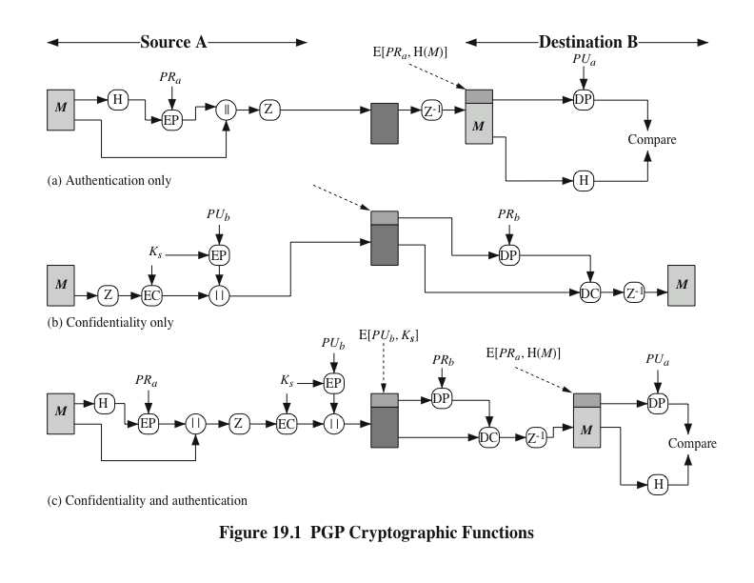
Notes:
Figure 19.1a illustrates the digital signature service provided by
PGP. This is the digital signature scheme discussed in Chapter 13 and illustrated in
Figure 13.2.
To protect the key, it is encrypted with the receiver’s public key. Figure 19.1b illustrates the sequence.
As Figure 19.1c illustrates, both services
may be used for the same message. First, a signature is generated for the plaintext
message and prepended to the message. Then the plaintext message plus signature
is encrypted using CAST-128 (or IDEA or 3DES), and the session key is encrypted
using RSA (or ElGamal). This sequence is preferable to the opposite: encrypting
the message and then generating a signature for the encrypted message. It is generally
more convenient to store a signature with a plaintext version of a message.
Furthermore, for purposes of third-party verification, if the signature is performed
first, a third party need not be concerned with the symmetric key when verifying the
signature.
In summary, when both services are used, the sender first signs the message
with its own private key, then encrypts the message with a session key, and finally
encrypts the session key with the recipient’s public key.

Slide 13
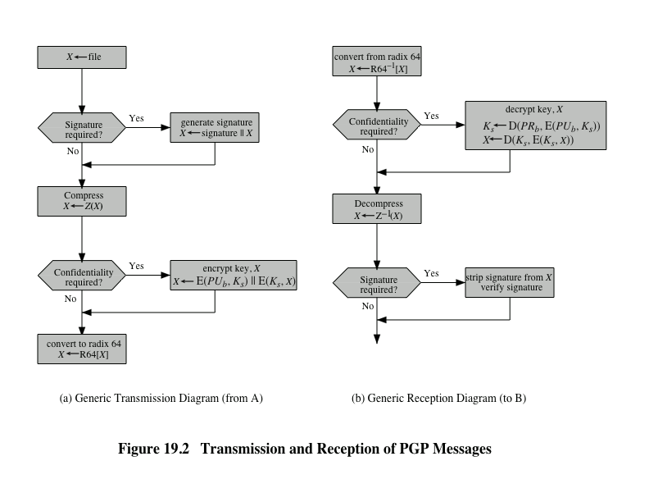
Notes:
Figure 19.2 shows the relationship among the four services so far discussed.
On transmission (if it is required), a signature is generated using a hash code of
the uncompressed plaintext. Then the plaintext (plus signature if present) is compressed.
Next, if confidentiality is required, the block (compressed plaintext or
compressed signature plus plaintext) is encrypted and prepended with the publickey-
encrypted symmetric encryption key. Finally, the entire block is converted to
radix-64 format.
On reception, the incoming block is first converted back from radix-64 format
to binary. Then, if the message is encrypted, the recipient recovers the session key
and decrypts the message. The resulting block is then decompressed. If the message
is signed, the recipient recovers the transmitted hash code and compares it to its
own calculation of the hash code.

Slide 14
Secure/Multipurpose Internet Mail Extension (S/MIME)
A security enhancement to the MIME Internet e-mail format standard based on technology from RSA Data Security
Defined in:
RFCs 3370, 3850, 3851, 3852
Notes:
Secure/Multipurpose Internet Mail Extension (S/MIME) is a security enhancement
to the MIME Internet e-mail format standard based on technology from RSA Data
Security. Although both PGP and S/MIME are on an IETF standards track, it appears
likely that S/MIME will emerge as the industry standard for commercial and
organizational use, while PGP will remain the choice for personal e-mail security
for many users. S/MIME is defined in a number of documents—most importantly
RFCs 3370, 3850, 3851, and 3852.
To understand S/MIME, we need first to have a general understanding of the underlying
e-mail format that it uses, namely MIME. But to understand the significance
of MIME, we need to go back to the traditional e-mail format standard, RFC 822,
which is still in common use. The most recent version of this format specification is
RFC 5322 (Internet Message Format ). Accordingly, this section first provides an introduction
to these two earlier standards and then moves on to a discussion of S/MIME.

Slide 15
RFC 5322
Defines a format for text messages that are sent using electronic mail
Messages are viewed as having an envelope and contents
The envelope contains whatever information is needed to accomplish transmission and delivery
The contents compose the object to be delivered to the recipient
RFC 5322 standard applies only to the contents
The content standard includes a set of header fields that may be used by the mail system to create the envelope
Notes:
RFC 5322 defines a format for text messages that are sent using electronic mail. It
has been the standard for Internet-based text mail messages and remains in common
use. In the RFC 5322 context, messages are viewed as having an envelope and
contents. The envelope contains whatever information is needed to accomplish
transmission and delivery. The contents compose the object to be delivered to the
recipient. The RFC 5322 standard applies only to the contents. However, the content
standard includes a set of header fields that may be used by the mail system to
create the envelope, and the standard is intended to facilitate the acquisition of such
information by programs.
The overall structure of a message that conforms to RFC 5322 is very simple.
A message consists of some number of header lines (the header ) followed by unrestricted
text (the body ). The header is separated from the body by a blank line. Put
differently, a message is ASCII text, and all lines up to the first blank line are assumed
to be header lines used by the user agent part of the mail system.
A header line usually consists of a keyword, followed by a colon, followed by
the keyword’s arguments; the format allows a long line to be broken up into several
lines. The most frequently used keywords are From , To , Subject , and Date .
Another field that is commonly found in RFC 5322 headers is Message-ID .
This field contains a unique identifier associated with this message.

Slide 16
Multipurpose Internet Mail Extensions (MIME)
MIME specification includes the following elements:
An extension to the RFC 5322 framework that is intended to address some of the problems and limitations of the use of Simple Mail Transfer Protocol (SMTP)
Is intended to resolve these problems in a manner that is compatible with existing RFC 5322 implementations
The specification is provided in RFCs 2045 through 2049
Notes:
Multipurpose Internet Mail Extension (MIME) is an extension to the RFC 5322
framework that is intended to address some of the problems and limitations of the
use of Simple Mail Transfer Protocol (SMTP), defined in RFC 821, or some other
mail transfer protocol and RFC 5322 for electronic mail.
MIME is intended to resolve these problems in a manner that is compatible
with existing RFC 5322 implementations. The specification is provided in RFCs
2045 through 2049.
The MIME specification includes the following elements.
1. Five new message header fields are defined, which may be included in an
RFC 5322 header. These fields provide information about the body of the
message.
2. A number of content formats are defined, thus standardizing representations
that support multimedia electronic mail.
3. Transfer encodings are defined that enable the conversion of any content format
into a form that is protected from alteration by the mail system.

Slide 17
The Five Header Fields Defined in MIME
Notes:
In this subsection, we introduce the five message header fields. The next two
subsections deal with content formats and transfer encodings.
The five header fields defined in MIME are
• MIME-Version: Must have the parameter value 1.0. This field indicates that
the message conforms to RFCs 2045 and 2046.
• Content-Type: Describes the data contained in the body with sufficient detail that
the receiving user agent can pick an appropriate agent or mechanism to represent
the data to the user or otherwise deal with the data in an appropriate manner.
• Content-Transfer-Encoding: Indicates the type of transformation that has
been used to represent the body of the message in a way that is acceptable for
mail transport.
• Content-ID: Used to identify MIME entities uniquely in multiple contexts.
• Content-Description: A text description of the object with the body; this is
useful when the object is not readable (e.g., audio data).
Any or all of these fields may appear in a normal RFC 5322 header. A compliant
implementation must support the MIME-Version, Content-Type, and
Content-Transfer-Encoding fields; the Content-ID and Content-Description fields
are optional and may be ignored by the recipient implementation.

Slide 18
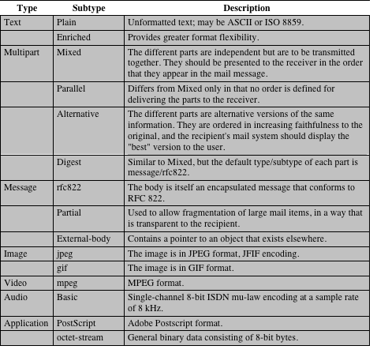
Table 19.2
MIME Content Types
Notes:
The bulk of the MIME specification is concerned with the
definition of a variety of content types. This reflects the need to provide standardized
ways of dealing with a wide variety of information representations in a multimedia
environment.
Table 19.2 lists the content types specified in RFC 2046. There are seven different
major types of content and a total of 15 subtypes. In general, a content type
declares the general type of data, and the subtype specifies a particular format for
that type of data.
For the text type of body, no special software is required to get the full meaning
of the text aside from support of the indicated character set. The primary subtype
is plain text , which is simply a string of ASCII characters or ISO 8859 characters. The
enriched subtype allows greater formatting flexibility.
The multipart type indicates that the body contains multiple, independent
parts. The Content-Type header field includes a parameter (called a boundary) that
defines the delimiter between body parts. This boundary should not appear in any
parts of the message. Each boundary starts on a new line and consists of two hyphens
followed by the boundary value. The final boundary, which indicates the end
of the last part, also has a suffix of two hyphens. Within each part, there may be an
optional ordinary MIME header.
There are four subtypes of the multipart type, all of which have the same overall
syntax. The multipart/mixed subtype is used when there are multiple independent
body parts that need to be bundled in a particular order. For the multipart/
parallel subtype, the order of the parts is not significant. If the recipient’s system is
appropriate, the multiple parts can be presented in parallel. For example, a picture
or text part could be accompanied by a voice commentary that is played while the
picture or text is displayed.
For the multipart/alternative subtype, the various parts are different representations
of the same information.
The multipart/digest subtype is used when each of the body parts is interpreted
as an RFC 5322 message with headers. This subtype enables the construction
of a message whose parts are individual messages. For example, the moderator of a
group might collect e-mail messages from participants, bundle these messages, and
send them out in one encapsulating MIME message.
The message type provides a number of important capabilities in MIME.
The message/rfc822 subtype indicates that the body is an entire message, including
header and body. Despite the name of this subtype, the encapsulated message may
be not only a simple RFC 5322 message but also any MIME message.
The message/partial subtype enables fragmentation of a large message into a
number of parts, which must be reassembled at the destination. For this subtype,
three parameters are specified in the Content-Type: Message/Partial field: an id
common to all fragments of the same message, a sequence number unique to each
fragment, and the total number of fragments.
The message/external-body subtype indicates that the actual data to be conveyed
in this message are not contained in the body. Instead, the body contains the
information needed to access the data. As with the other message types, the message/
external-body subtype has an outer header and an encapsulated message with
its own header. The only necessary field in the outer header is the Content-Type
field, which identifies this as a message/external-body subtype. The inner header is
the message header for the encapsulated message. The Content-Type field in the
outer header must include an access-type parameter, which indicates the method of
access, such as FTP (file transfer protocol).
The application type refers to other kinds of data, typically either uninterpreted
binary data or information to be processed by a mail-based application.

Slide 19
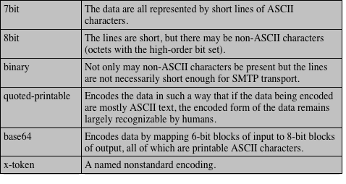
Table 19.3
MIME Transfer Encodings
Notes:
The other major component of the MIME specification,
in addition to content type specification, is a definition of transfer encodings
for message bodies. The objective is to provide reliable delivery across the largest
range of environments.
The MIME standard defines two methods of encoding data. The Content-
Transfer-Encoding field can actually take on six values, as listed in Table 19.3.
However, three of these values (7bit, 8bit, and binary) indicate that no encoding
has been done but provide some information about the nature of the data. For
SMTP transfer, it is safe to use the 7bit form. The 8bit and binary forms may be usable
in other mail transport contexts. Another Content-Transfer-Encoding value is
x-token, which indicates that some other encoding scheme is used for which a name
is to be supplied. This could be a vendor-specific or application-specific scheme.
The two actual encoding schemes defined are quoted-printable and base64. Two
schemes are defined to provide a choice between a transfer technique that is essentially
human readable and one that is safe for all types of data in a way that is
reasonably compact.
The quoted-printable transfer encoding is useful when the data consists largely
of octets that correspond to printable ASCII characters. In essence, it represents
nonsafe characters by the hexadecimal representation of their code and introduces
reversible (soft) line breaks to limit message lines to 76 characters.
The base64 transfer encoding, also known as radix-64 encoding, is a common
one for encoding arbitrary binary data in such a way as to be invulnerable to the
processing by mail-transport programs. It is also used in PGP and is described in
Appendix 19A.

Slide 20
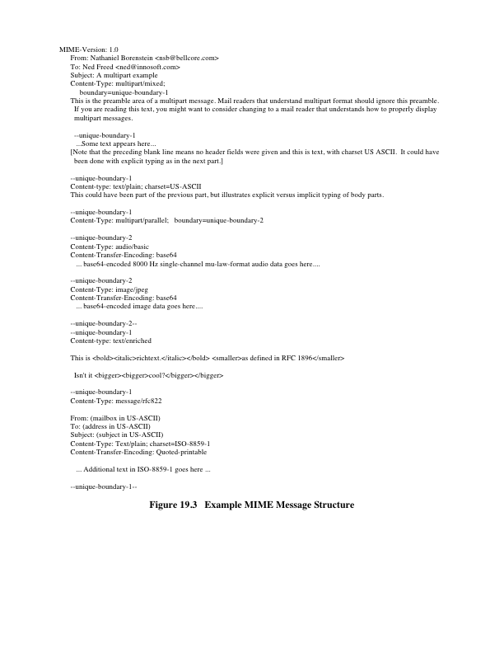
Notes:
Figure 19.3, taken from RFC 2045, is the outline of a complex
multipart message. The message has five parts to be displayed serially: two
introductory plain text parts, an embedded multipart message, a richtext part, and
a closing encapsulated text message in a non-ASCII character set. The embedded
multipart message has two parts to be displayed in parallel: a picture and an audio
fragment.

Slide 21
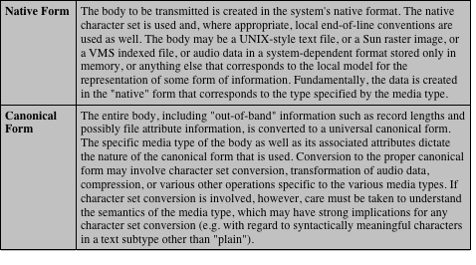
Table 19.4
Native and Canonical Form
Notes:
An important concept in MIME and S/MIME is that of canonical
form. Canonical form is a format, appropriate to the content type, that is standardized
for use between systems. This is in contrast to native form, which is a format
that may be peculiar to a particular system. Table 19.4, from RFC 2049, should help
clarify this matter.

Slide 22
S/MIME Functionality
Notes:
In terms of general functionality, S/MIME is very similar to PGP. Both offer the
ability to sign and/or encrypt messages. In this subsection, we briefly summarize
S/MIME capability. We then look in more detail at this capability by examining
message formats and message preparation.
S/MIME provides the following functions.
• Enveloped data: This consists of encrypted content of any type and encrypted content
encryption keys for one or more recipients.
• Signed data: A digital signature is formed by taking the message digest of
the content to be signed and then encrypting that with the private key of
the signer. The content plus signature are then encoded using base64 encoding.
A signed data message can only be viewed by a recipient with S/MIME
capability.
• Clear-signed data: As with signed data, a digital signature of the content is
formed. However, in this case, only the digital signature is encoded using
base64. As a result, recipients without S/MIME capability can view the message
content, although they cannot verify the signature.
• Signed and enveloped data: Signed-only and encrypted-only entities may be
nested, so that encrypted data may be signed and signed data or clear-signed
data may be encrypted.

Slide 23
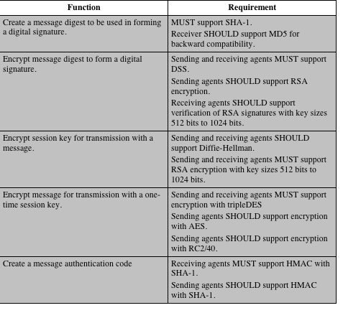
Table 19.5
Cryptographic
Algorithms
Used in
S/MIME
Notes:
Table 19.5 summarizes the cryptographic algorithms
used in S/MIME. S/MIME uses the following terminology taken from RFC 2119
(Key Words for use in RFCs to Indicate Requirement Levels ) to specify the requirement
level:
• MUST: The definition is an absolute requirement of the specification. An implementation
must include this feature or function to be in conformance with
the specification.
• SHOULD: There may exist valid reasons in particular circumstances to ignore
this feature or function, but it is recommended that an implementation include
the feature or function.
S/MIME incorporates three public-key algorithms. The Digital Signature
Standard (DSS) described in Chapter 13 is the preferred algorithm for digital signature.
S/MIME lists Diffie-Hellman as the preferred algorithm for encrypting
session keys; in fact, S/MIME uses a variant of Diffie-Hellman that does provide
encryption/decryption, known as ElGamal (Chapter 10). As an alternative, RSA,
described in Chapter 9, can be used for both signatures and session key encryption.
These are the same algorithms used in PGP and provide a high level of security. For
the hash function used to create the digital signature, the specification requires the
160-bit SHA-1 but recommends receiver support for the 128-bit MD5 for backward
compatibility with older versions of S/MIME. As we discussed in Chapter 11, there
is justifiable concern about the security of MD5, so SHA-1 is clearly the preferred
alternative.
For message encryption, three-key triple DES (tripleDES) is recommended,
but compliant implementations must support 40-bit RC2. The latter is a weak encryption
algorithm but allows compliance with U.S. export controls.
The S/MIME specification includes a discussion of the procedure for deciding
which content encryption algorithm to use. In essence, a sending agent has two
decisions to make. First, the sending agent must determine if the receiving agent is
capable of decrypting using a given encryption algorithm. Second, if the receiving
agent is only capable of accepting weakly encrypted content, the sending agent must
decide if it is acceptable to send using weak encryption. To support this decision
process, a sending agent may announce its decrypting capabilities in order of preference
for any message that it sends out. A receiving agent may store that information
for future use.

Slide 24
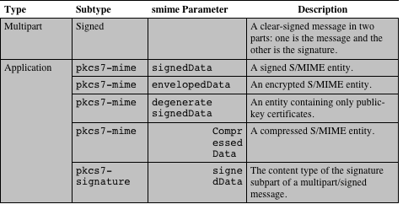
Table 19.6
S/MIME Content Types
Notes:
S/MIME makes use of a number of new MIME content types, which are shown in
Table 19.6. All of the new application types use the designation PKCS. This refers
to a set of public-key cryptography specifications issued by RSA Laboratories and
made available for the S/MIME effort.

Slide 25
Securing a MIME Entity
S/MIME secures a MIME entity with a signature, encryption, or both
The MIME entity is prepared according to the normal rules for MIME message preparation
The MIME entity plus some security-related data, such as algorithm identifiers and certificates, are processed by S/MIME to produce what is known as a PKCS object
A PKCS object is then treated as message content and wrapped in MIME
In all cases the message to be sent is converted to canonical form
Notes:
S/MIME secures a MIME entity with a signature,
encryption, or both. A MIME entity may be an entire message (except for the
RFC 5322 headers), or if the MIME content type is multipart, then a MIME entity
is one or more of the subparts of the message. The MIME entity is prepared according
to the normal rules for MIME message preparation. Then the MIME entity
plus some security-related data, such as algorithm identifiers and certificates, are
processed by S/MIME to produce what is known as a PKCS object. A PKCS object
is then treated as message content and wrapped in MIME (provided with appropriate
MIME headers). This process should become clear as we look at specific objects
and provide examples.
In all cases, the message to be sent is converted to canonical form. In particular,
for a given type and subtype, the appropriate canonical form is used for the
message content. For a multipart message, the appropriate canonical form is used
for each subpart.
The use of transfer encoding requires special attention. For most cases, the
result of applying the security algorithm will be to produce an object that is partially
or totally represented in arbitrary binary data. This will then be wrapped in an
outer MIME message, and transfer encoding can be applied at that point, typically
base64. However, in the case of a multipart signed message (described in more detail
later), the message content in one of the subparts is unchanged by the security
process. Unless that content is 7bit, it should be transfer encoded using base64 or
quoted-printable so that there is no danger of altering the content to which the signature
was applied.

Slide 26
EnvelopedData
The steps for preparing an envelopedData MIME are:
Notes:
An application/pkcs7-mime subtype is used for one of four
categories of S/MIME processing, each with a unique smime-type parameter. In all
cases, the resulting entity (referred to as an object) is represented in a form known
as Basic Encoding Rules (BER), which is defined in ITU-T Recommendation
X.209. The BER format consists of arbitrary octet strings and is therefore binary
data. Such an object should be transfer encoded with base64 in the outer MIME
message. We first look at envelopedData.
The steps for preparing an envelopedData MIME entity are
1. Generate a pseudorandom session key for a particular symmetric encryption
algorithm (RC2/40 or triple DES).
2. For each recipient, encrypt the session key with the recipient’s public RSA key.
3. For each recipient, prepare a block known as RecipientInfo that contains
an identifier of the recipient’s public-key certificate, an identifier of the algorithm
used to encrypt the session key, and the encrypted session key.
4. Encrypt the message content with the session key.
The RecipientInfo blocks followed by the encrypted content constitute
the envelopedData . This information is then encoded into base64.
To recover the encrypted message, the recipient first strips off the base64 encoding.
Then the recipient’s private key is used to recover the session key. Finally,
the message content is decrypted with the session key.

Slide 27
SignedData
The steps for preparing a signedData MIME are:
Notes:
The signedData smime-type can be used with one or more signers.
For clarity, we confine our description to the case of a single digital signature. The
steps for preparing a signedData MIME entity are
1. Select a message digest algorithm (SHA or MD5).
2. Compute the message digest (hash function) of the content to be signed.
3. Encrypt the message digest with the signer’s private key.
4. Prepare a block known as SignerInfo that contains the signer’s public-key
certificate, an identifier of the message digest algorithm, an identifier of the algorithm
used to encrypt the message digest, and the encrypted message digest.
The signedData entity consists of a series of blocks, including a message
digest algorithm identifier, the message being signed, and SignerInfo . The
signedData entity may also include a set of public-key certificates sufficient to
constitute a chain from a recognized root or top-level certification authority to the
signer. This information is then encoded into base64.
To recover the signed message and verify the signature, the recipient first
strips off the base64 encoding. Then the signer’s public key is used to decrypt the
message digest. The recipient independently computes the message digest and compares
it to the decrypted message digest to verify the signature.

Slide 28
Clear Signing
Achieved using the multipart content type with a signed subtype
This signing process does not involve transforming the message to be signed
Recipients with MIME capability but not S/MIME capability are able to read the incoming message
Notes:
Clear signing is achieved using the multipart content type with a signed
subtype. As was mentioned, this signing process does not involve transforming the
message to be signed, so that the message is sent “in the clear.” Thus, recipients with
MIME capability but not S/MIME capability are able to read the incoming message.
A multipart/signed message has two parts. The first part can be any MIME
type but must be prepared so that it will not be altered during transfer from source
to destination. This means that if the first part is not 7bit, then it needs to be encoded
using base64 or quoted-printable. Then this part is processed in the same
manner as signedData , but in this case an object with signedData format is
created that has an empty message content field. This object is a detached signature.
It is then transfer encoded using base64 to become the second part of the multipart/
signed message. This second part has a MIME content type of application and a
subtype of pkcs7-signature.

Slide 29
S/MIME Certificate Processing
S/MIME uses public-key certificates that conform to version 3 of X.509
The key-management scheme used by S/MIME is in some ways a hybrid between a strict X.509 certification hierarchy and PGP’s web of trust
S/MIME managers and/or users must configure each client with a list of trusted keys and with certificate revocation lists
The responsibility is local for maintaining the certificates needed to verify incoming signatures and to encrypt outgoing messages
The certificates are signed by certification authorities
Notes:
S/MIME uses public-key certificates that conform to version 3 of X.509 (see
Chapter 14). The key-management scheme used by S/MIME is in some ways a hybrid
between a strict X.509 certification hierarchy and PGP’s web of trust. As with
the PGP model, S/MIME managers and/or users must configure each client with a
list of trusted keys and with certificate revocation lists. That is, the responsibility is
local for maintaining the certificates needed to verify incoming signatures and to
encrypt outgoing messages. On the other hand, the certificates are signed by certification
authorities.

Slide 30
User Agent Role
An S/MIME user has several key-management functions to perform:
Notes:
An S/MIME user has several key-management functions to
perform.
• Key generation: The user of some related administrative utility (e.g., one associated
with LAN management) MUST be capable of generating separate
Diffie-Hellman and DSS key pairs and SHOULD be capable of generating
RSA key pairs. Each key pair MUST be generated from a good source of
nondeterministic random input and be protected in a secure fashion. A user
agent SHOULD generate RSA key pairs with a length in the range of 768 to
1024 bits and MUST NOT generate a length of less than 512 bits.
• Registration: A user’s public key must be registered with a certification authority
in order to receive an X.509 public-key certificate.
• Certificate storage and retrieval: A user requires access to a local list of certificates
in order to verify incoming signatures and to encrypt outgoing messages.
Such a list could be maintained by the user or by some local administrative
entity on behalf of a number of users.

Slide 31
VeriSign Certificates
VeriSign provides a certification authority (CA) service that is intended to be compatible with S/MIME and a variety of other applications
Issues X.509 certificates with the product name VeriSign Digital ID
At a minimum, each Digital ID contains:
Owner’s public key
Owner’s name or alias
Expiration date of the Digital ID
Serial number of the Digital ID
Name of the certification authority that issued the Digital ID
Digital signature of the certification authority that issued the Digital ID
Notes:
There are several companies that provide certification authority
(CA) services. For example, Nortel has designed an enterprise CA solution
and can provide S/MIME support within an organization. There are a number
of Internet-based CAs, including VeriSign, GTE, and the U.S. Postal Service. Of
these, the most widely used is the VeriSign CA service, a brief description of which
we now provide.
VeriSign provides a CA service that is intended to be compatible with
S/MIME and a variety of other applications. VeriSign issues X.509 certificates
with the product name VeriSign Digital ID. As of early 1998, over 35,000 commercial
Web sites were using VeriSign Server Digital IDs, and over a million
consumer Digital IDs had been issued to users of Netscape and Microsoft
browsers.
The information contained in a Digital ID depends on the type of Digital ID
and its use. At a minimum, each Digital ID contains
• Owner’s public key
• Owner’s name or alias
• Expiration date of the Digital ID
• Serial number of the Digital ID
• Name of the certification authority that issued the Digital ID
• Digital signature of the certification authority that issued the Digital ID
Digital IDs can also contain other user-supplied information, including
• Address
• E-mail address
• Basic registration information (country, zip code, age, and gender)

Slide 32
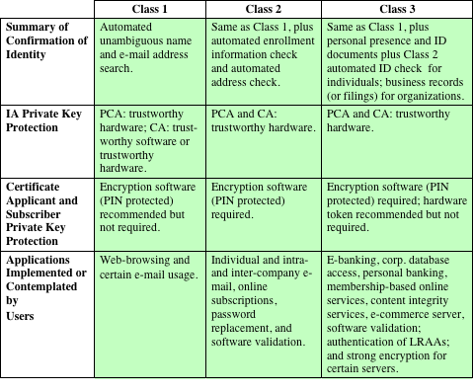
Table 19.7
VeriSign Public-Key Certificate Classes
IA Issuing Authority
CA Certification Authority
PCA VeriSign public primary certification authority
PIN Personal Identification Number
LRAA Local Registration Authority Administrator
Notes:
VeriSign provides three levels, or classes, of security for public-key certificates,
as summarized in Table 19.7. A user requests a certificate online at VeriSign’s
Web site or other participating Web sites. Class 1 and Class 2 requests are processed
on line, and in most cases take only a few seconds to approve. Briefly, the following
procedures are used.
• For Class 1 Digital IDs, VeriSign confirms the user’s e-mail address by sending
a PIN and Digital ID pick-up information to the e-mail address provided
in the application.
• For Class 2 Digital IDs, VeriSign verifies the information in the application
through an automated comparison with a consumer database in addition to
performing all of the checking associated with a Class 1 Digital ID. Finally,
confirmation is sent to the specified postal address alerting the user that a
Digital ID has been issued in his or her name.
• For Class 3 Digital IDs, VeriSign requires a higher level of identity assurance.
An individual must prove his or her identity by providing notarized credentials
or applying in person.

Slide 33
Enhanced Security Services
Three enhanced security services have been proposed in an Internet draft:
Signed receipt
Returning a signed receipt provides proof of delivery to the originator of a message and allows the originator to demonstrate to a third party that the recipient received the message
Security labels
A set of security information regarding the sensitivity of the content that is protected by S/MIME encapsulation
Secure mailing lists
An S/MIME Mail List Agent (MLA) can take a single incoming message, perform the recipient-specific encryption for each recipient, and forward the message
Notes:
As of this writing, three enhanced security services have been proposed in an
Internet draft. The details of these may change, and additional services may be
added. The three services are
• Signed receipts: A signed receipt may be requested in a SignedData object.
Returning a signed receipt provides proof of delivery to the originator of a
message and allows the originator to demonstrate to a third party that the recipient
received the message. In essence, the recipient signs the entire original
message plus the original (sender’s) signature and appends the new signature
to form a new S/MIME message.
• Security labels: A security label may be included in the authenticated attributes
of a SignedData object. A security label is a set of security information
regarding the sensitivity of the content that is protected by S/MIME encapsulation.
The labels may be used for access control, by indicating which users are
permitted access to an object. Other uses include priority (secret, confidential,
restricted, and so on) or role based, describing which kind of people can see
the information (e.g., patient’s health-care team, medical billing agents, etc.).
• Secure mailing lists: When a user sends a message to multiple recipients, a certain
amount of per-recipient processing is required, including the use of each
recipient’s public key. The user can be relieved of this work by employing the
services of an S/MIME Mail List Agent (MLA). An MLA can take a single
incoming message, perform the recipient-specific encryption for each recipient,
and forward the message. The originator of a message need only send the
message to the MLA with encryption performed using the MLA’s public key.

Slide 34
DomainKeys Identified Mail (DKIM)
A specification for cryptographically signing e-mail messages, permitting a signing domain to claim responsibility for a message in the mail stream
Message recipients can verify the signature by querying the signer’s domain directly to retrieve the appropriate public key and can thereby confirm that the message was attested to by a party in possession of the private key for the signing domain
Proposed Internet Standard RFC 4871
Has been widely adopted by a range of e-mail providers and Internet Service Providers (ISPs)
Notes:
DomainKeys Identified Mail (DKIM) is a specification for cryptographically signing
e-mail messages, permitting a signing domain to claim responsibility for a message
in the mail stream. Message recipients (or agents acting in their behalf) can verify
the signature by querying the signer’s domain directly to retrieve the appropriate
public key and thereby can confirm that the message was attested to by a party in
possession of the private key for the signing domain. DKIM is a proposed Internet
Standard (RFC 4871: DomainKeys Identified Mail (DKIM) Signatures ). DKIM has
been widely adopted by a range of e-mail providers, including corporations, government
agencies, gmail, yahoo, and many Internet Service Providers (ISPs).

Slide 35
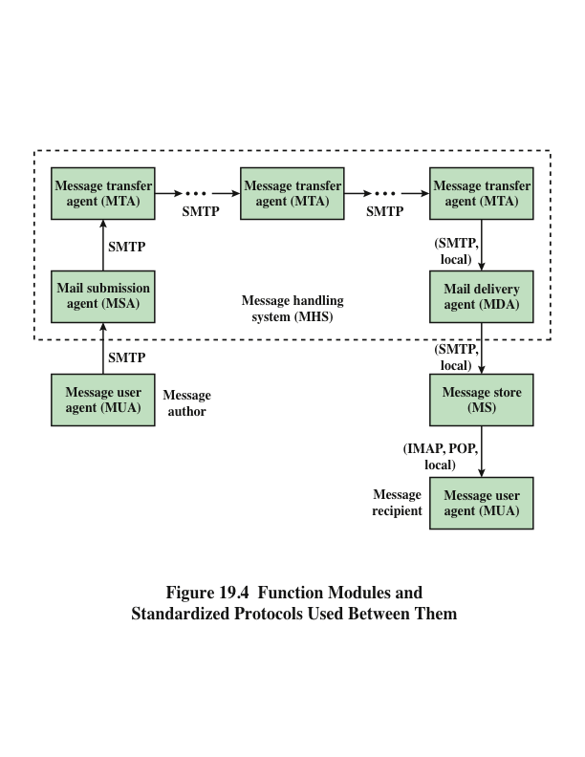
Notes:
To understand the operation of DKIM, it is useful to have a basic grasp of the
Internet mail architecture, which is currently defined in RFC 5598. This subsection
provides an overview of the basic concepts.
At its most fundamental level, the Internet mail architecture consists of a
user world in the form of Message User Agents (MUA), and the transfer world, in
the form of the Message Handling Service (MHS), which is composed of Message
Transfer Agents (MTA). The MHS accepts a message from one user and delivers
it to one or more other users, creating a virtual MUA-to-MUA exchange environment.
This architecture involves three types of interoperability. One is directly between
users: messages must be formatted by the MUA on behalf of the message
author so that the message can be displayed to the message recipient by the destination
MUA. There are also interoperability requirements between the MUA and the
MHS—first when a message is posted from an MUA to the MHS and later when
it is delivered from the MHS to the destination MUA. Interoperability is required
among the MTA components along the transfer path through the MHS.
Figure 19.4 illustrates the key components of the Internet mail architecture,
which include the following.
• Message User Agent (MUA): Operates on behalf of user actors and user applications.
It is their representative within the e-mail service. Typically, this
function is housed in the user’s computer and is referred to as a client e-mail
program or a local network e-mail server. The author MUA formats a message
and performs initial submission into the MHS via a MSA. The recipient
MUA processes received mail for storage and/or display to the recipient user.
• Mail Submission Agent (MSA): Accepts the message submitted by an MUA
and enforces the policies of the hosting domain and the requirements of
Internet standards. This function may be located together with the MUA or
as a separate functional model. In the latter case, the Simple Mail Transfer
Protocol (SMTP) is used between the MUA and the MSA.
• Message Transfer Agent (MTA): Relays mail for one application-level hop.
It is like a packet switch or IP router in that its job is to make routing assessments
and to move the message closer to the recipients. Relaying is performed
by a sequence of MTAs until the message reaches a destination MDA. An
MTA also adds trace information to the message header. SMTP is used between
MTAs and between an MTA and an MSA or MDA.
• Mail Delivery Agent (MDA): Responsible for transferring the message from
the MHS to the MS.
• Message Store (MS): An MUA can employ a long-term MS. An MS can be
located on a remote server or on the same machine as the MUA. Typically,
an MUA retrieves messages from a remote server using POP (Post Office
Protocol) or IMAP (Internet Message Access Protocol).
Two other concepts need to be defined. An administrative management
domain (ADMD) is an Internet e-mail provider. Examples include a department
that operates a local mail relay (MTA), an IT department that operates an enterprise
mail relay, and an ISP that operates a public shared e-mail service. Each
ADMD can have different operating policies and trust-based decision making. One
obvious example is the distinction between mail that is exchanged within an organization
and mail that is exchanged between independent organizations. The rules for
handling the two types of traffic tend to be quite different.
The Domain Name System (DNS) is a directory lookup service that provides
a mapping between the name of a host on the Internet and its numerical address.

Slide 36
E-mail Threats
RFC 4684 (Analysis of Threats Motivating DomainKeys Identified Mail)
Describes the threats being addressed by DKIM in terms of the characteristics, capabilities, and location of potential attackers
Characterized on three levels of threat:
Notes:
RFC 4686 characterizes the range of attackers on a spectrum of
three levels of threat.
1. At the low end are attackers who simply want to send e-mail that a recipient
does not want to receive. The attacker can use one of a number of commercially
available tools that allow the sender to falsify the origin address of
messages. This makes it difficult for the receiver to filter spam on the basis of
originating address or domain.
2. At the next level are professional senders of bulk spam mail. These attackers
often operate as commercial enterprises and send messages on behalf of third
parties. They employ more comprehensive tools for attack, including Mail
Transfer Agents (MTAs) and registered domains and networks of compromised
computers (zombies) to send messages and (in some cases) to harvest
addresses to which to send.
3. The most sophisticated and financially motivated senders of messages are
those who stand to receive substantial financial benefit, such as from an
E-mail-based fraud scheme. These attackers can be expected to employ all of
the above mechanisms and additionally may attack the Internet infrastructure
itself, including DNS cache-poisoning attacks and IP routing attacks.

Slide 37
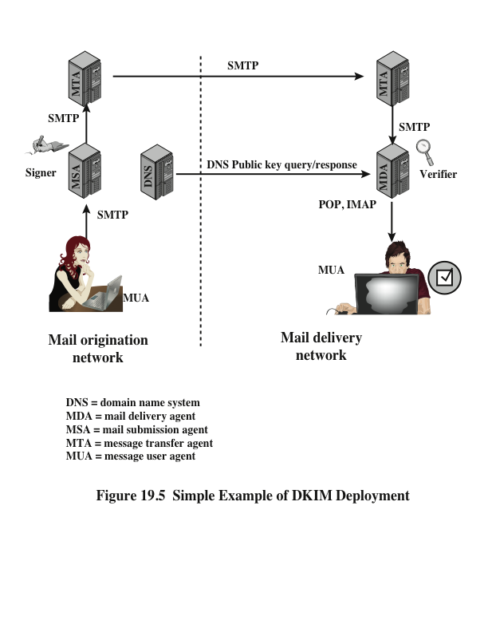
Notes:
DKIM is designed to provide an e-mail authentication technique that is transparent
to the end user. In essence, a user’s e-mail message is signed by a private key of the
administrative domain from which the e-mail originates. The signature covers all of
the content of the message and some of the RFC 5322 message headers. At the receiving
end, the MDA can access the corresponding public key via a DNS and verify
the signature, thus authenticating that the message comes from the claimed administrative
domain. Thus, mail that originates from somewhere else but claims to come
from a given domain will not pass the authentication test and can be rejected. This
approach differs from that of S/MIME and PGP, which use the originator’s private
key to sign the content of the message. The motivation for DKIM is based on the
following reasoning.
1. S/MIME depends on both the sending and receiving users employing S/MIME.
For almost all users, the bulk of incoming mail does not use S/MIME, and the
bulk of the mail the user wants to send is to recipients not using S/MIME.
2. S/MIME signs only the message content. Thus, RFC 5322 header information
concerning origin can be compromised.
3. DKIM is not implemented in client programs (MUAs) and is therefore transparent
to the user; the user need take no action.
4. DKIM applies to all mail from cooperating domains.
5. DKIM allows good senders to prove that they did send a particular message
and to prevent forgers from masquerading as good senders.
Figure 19.5 is a simple example of the operation of DKIM. We begin with a
message generated by a user and transmitted into the MHS to an MSA that is within
the user’s administrative domain. An e-mail message is generated by an e-mail client
program. The content of the message, plus selected RFC 5322 headers, is signed
by the e-mail provider using the provider’s private key. The signer is associated
with a domain, which could be a corporate local network, an ISP, or a public e-mail
facility such as gmail. The signed message then passes through the Internet via a
sequence of MTAs. At the destination, the MDA retrieves the public key for the
incoming signature and verifies the signature before passing the message on to the
destination e-mail client. The default signing algorithm is RSA with SHA-256. RSA
with SHA-1 also may be used.

Slide 38
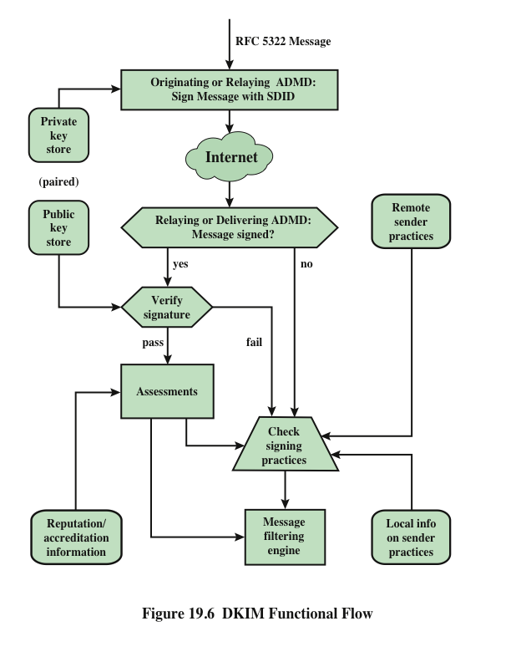
Notes:
Figure 19.6 provides a more detailed look at the elements of DKIM operation. Basic
message processing is divided between a signing Administrative Management Domain
(ADMD) and a verifying ADMD. At its simplest, this is between the originating ADMD
and the delivering ADMD, but it can involve other ADMDs in the handling path.
Signing is performed by an authorized module within the signing ADMD and
uses private information from a Key Store. Within the originating ADMD, this
might be performed by the MUA, MSA, or an MTA. Verifying is performed by
an authorized module within the verifying ADMD. Within a delivering ADMD,
verifying might be performed by an MTA, MDA, or MUA. The module verifies
the signature or determines whether a particular signature was required. Verifying
the signature uses public information from the Key Store. If the signature passes,
reputation information is used to assess the signer and that information is passed
to the message filtering system. If the signature fails or there is no signature using
the author’s domain, information about signing practices related to the author can
be retrieved remotely and/or locally, and that information is passed to the message
filtering system. For example, if the sender (e.g., gmail) uses DKIM but no DKIM
signature is present, then the message may be considered fraudulent.
The signature is inserted into the RFC 5322 message as an additional header
entry, starting with the keyword Dkim-Signature . You can view examples from
your own incoming mail by using the View Long Headers (or similar wording)
option for an incoming message.
Before a message is signed, a process known as canonicalization is performed
on both the header and body of the RFC 5322 message. Canonicalization is necessary
to deal with the possibility of minor changes in the message made en route,
including character encoding, treatment of trailing white space in message lines, and
the “folding” and “unfolding” of header lines. The intent of canonicalization is to
make a minimal transformation of the message (for the purpose of signing; the message
itself is not changed, so the canonicalization must be performed again by the
verifier) that will give it its best chance of producing the same canonical value at the
receiving end. DKIM defines two header canonicalization algorithms (“simple” and
“relaxed”) and two for the body (with the same names). The simple algorithm tolerates
almost no modification, while the relaxed tolerates common modifications.
The signature includes a number of fields. Each field begins with a tag consisting
of a tag code followed by an equals sign and ends with a semicolon.

Slide 39
Summary
Pretty good privacy
Notation
Operational description
DomainKeys Identified Mail
Internet mail architecture
E-mail threats
DKIM strategy
DKIM functional flow
S/MIME
RFC 5322
Multipurpose Internet mail extensions
S/MIME functionality
S/MIME messages
S/MIME certification processing
Enhanced security services
Notes:
Chapter 19 summary.

